Slide 1

Capstone – Alternative Cities: Lifestyles Analysis
Author/analyst – Dale Hunter

Slide 2
“You will never feel truly satisfied by work until you are satisfied by life.”
- Heather schuck

Slide 3
Where do you want to live if you are not “tied” to an office?
Working from Home (Remote) has provided individuals an alternative to living where they work or go to school.
How do you find that city that has the “feel”, the “life” that you want to be able to explore, be a part of, and have it out your front door?
Has there been cities you have visited that you can say – “I would love to live here!!” ??
With some data, tools and data analytics/visualization methodology - You can begin to explore those questions and set on an adventure to what city might best meet your lifestyle!

Slide 4
The Data and Methodology
Scope : Kansas City, MO, Ft. Collins, CO and Portland, OR
Mapping data for 3 locations wanting to explore using Folium maps in Python
Foursquare data through an API to plot venues and then analyze venue categories to get a summary of neighborhoods(zip codes) where venues of common interest cluster.
Housing data from Realtor.com “realtor.com market hotness index” to compare housing pricing within and across cities being looked at.
This is a sample of the data to include the “fun” stuff to look at and the reality of cost
However – template provides for more data to build on other data that will provide you flexibility in look at other features!

Slide 5
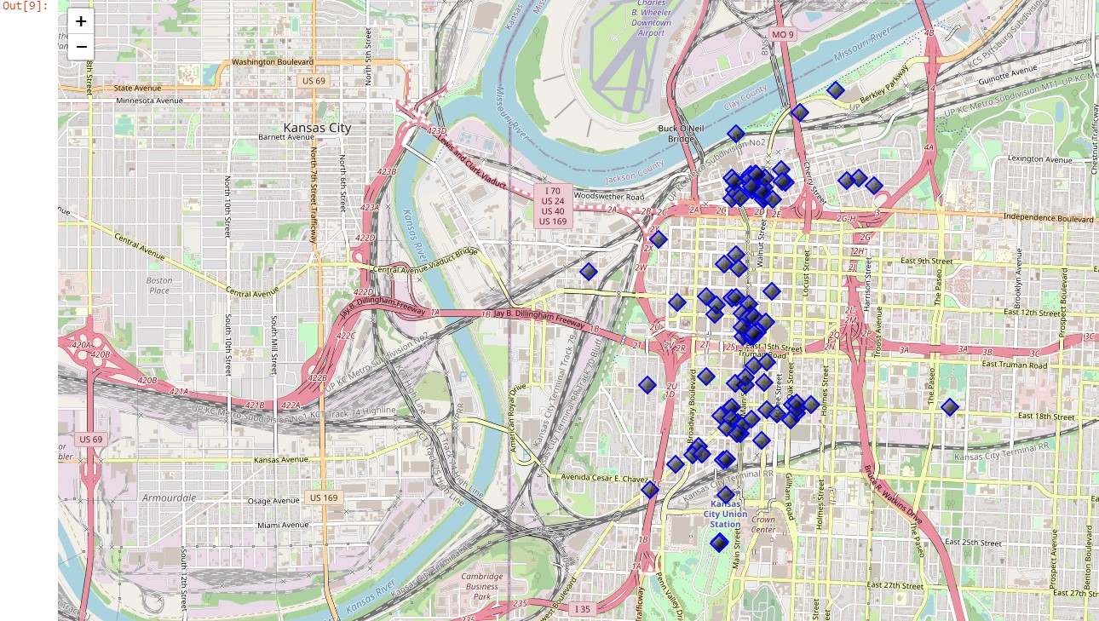
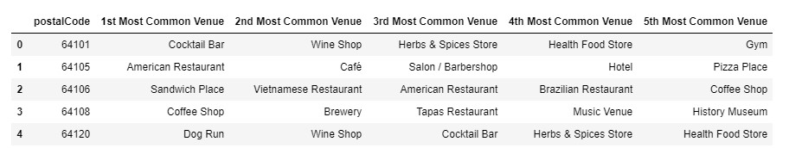
The Results
Kansas City, MO

Slide 6
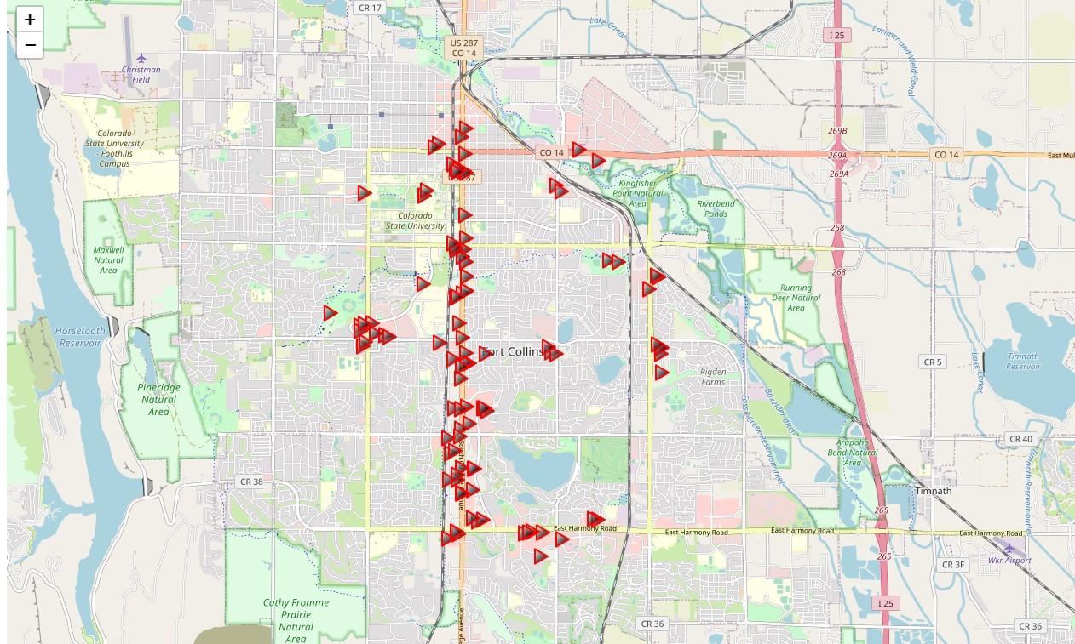
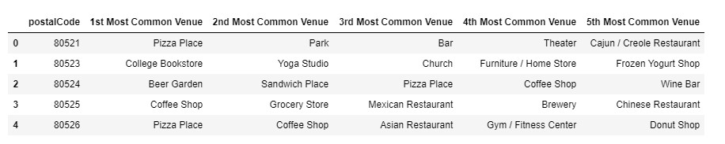
The Results
Fort Collins, CO

Slide 7
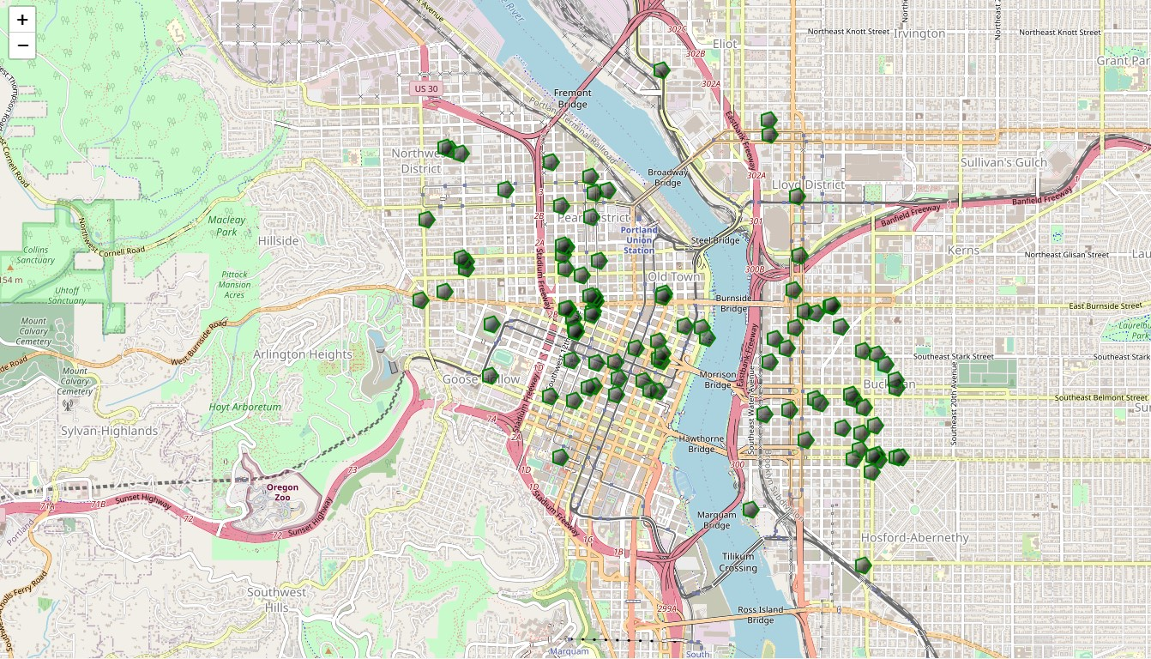
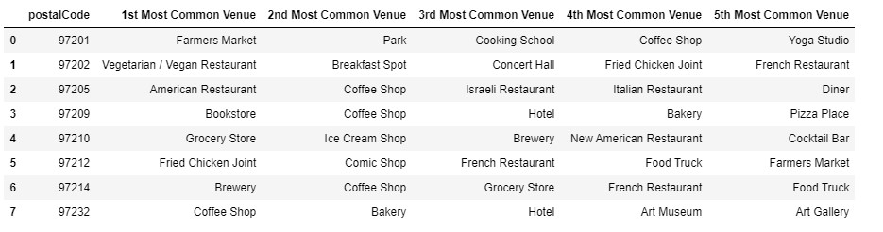
The Results
Portland, OR

Slide 8
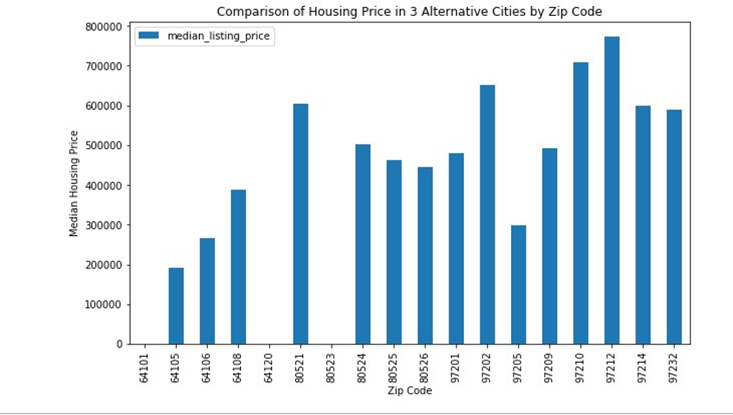
Kansas City, MO | Fort Collins, CO | Portland, OR
The Results
Housing Prices are lowest in Kansas City outside of one zipcode (97205) in Portland

Slide 9
Discussion/Recommendations/Conclusions
Take advantage of Foursquare/Folium mapping to explore venues that are of interest to each person and pay attention to the “natural” features of Folium to get a “birds-eye” view of the city and areas of interest denoted on the map
Additional data may be added to this analysis for crime rate, healthcare availability or other factors beneficial for your discovery and decision-making process.
Types of housing may need to be drilled-down using other sources for alternative housing, including, apartments and lofts.
We will be looking at Kansas City, MO first for our next city “living” destination, but the analysis and coding framework allow anyone to have a “toolkit” to do the same comparison of other cities and other data points to start their adventure in exploring alternative places to live!

